Slide 1
Reliability, Validity, and Ethics in Sports Analytics
Saryu Onishi
HES 3000-002, Sport Performance Analytics
Notes:
Some people seem to have done some level of analysis already
Overwhelming, difficult to know what variable applies
Be careful about jumping to conclusions and/or doing analysis to confirm your view point

Slide 2
Illusion of precision
Media framing implies that GPS vests, force plates, and optical tracking systems give us an infallible, objective window into an athlete's soul and body.
Systems may produce numbers with multiple decimal places, but precision does not guarantee accuracy.

Slide 3
Messy data
Sport data are affected by:
  Inconsistent procedures
  Human error
  Environmental conditions
  Missing observations
Before analyzing performance, we must understand how the data were produced.

Slide 4
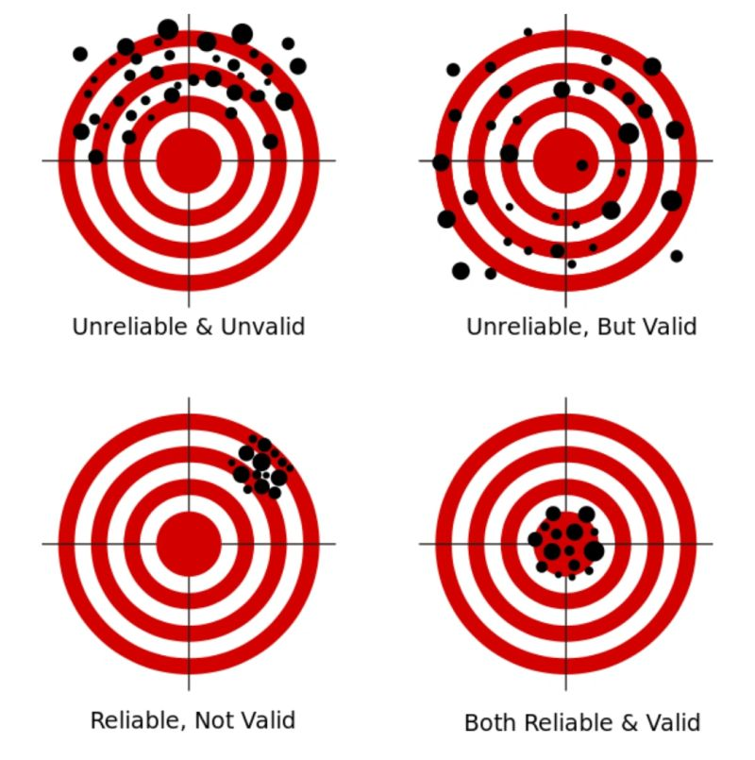
Trust in the measurement
Concept | Primary question
Reliability | Can the measurement be reproduced consistently?
Validity | Does the measurement represent what we intend to measure?

Slide 5
Reliability = Consistency
A reliable measurement produces similar results when the underlying performance has not meaningfully changed
Potential sources of inconsistency include:
  Device measurement error
  Device-to-device differences
  Rater or analyst differences
  Inconsistent testing procedures
  Normal biological variation

Slide 6
Types of reliability
Test–retest reliability
  Does the same athlete produce similar results when the test is repeated under similar conditions?
  Eg: 1RM
Intra-rater reliability
  Does the same observer produce similar measurements when repeating the process?
  Eg: same statistician quantifying player stats
Inter-rater reliability
  Do different observers produce similar measurements?
  Eg: multiple statisticians quantifying player stats
How can we make sure data is reliable?
Notes:
How can we make sure data is reliable?

Slide 7
Reliable… but valid?
An athlete completes the same jump test three times under similar conditions:
  Trial 1: 19.2 in
  Trial 2: 19.5 in
  Trial 3: 19.4 in
Is our data reliable?
  appears highly reliable.
This does not tell us whether the device is measuring jump height correctly.

Slide 8
Validity = Measuring What We Intend
A valid measurement accurately represents the concept or outcome we want to study.
Examples:
  Does the device accurately measure distance traveled?
  Does “player load” represent overall physical stress?
  Does AVG represent offensive contribution?

Slide 9
Types of Validity
Criterion validity
  Does the measurement agree with an accepted reference method?
  Eg: jump height
Construct validity
  Does the measurement behave as expected based on the underlying concept?
  Eg: RPE vs actual intensity
Ecological validity
  Does the measurement represent performance in the real sporting environment?
  Eg: lab test results vs on-field performance

Slide 10
Reliable but Not Valid
Imagine a bathroom scale that always reports weight 5 kg too high.
It gives consistent measurements → reliable
It does not give accurate measurements → not valid.
In sport, a metric may consistently measure something without measuring what coaches think it measures.
  Is this a problem?

Slide 11
Understanding What the Metric Actually Means
Consider “player load.”
A device may calculate player load consistently, but:
  Does it measure total physiological stress?
  Does it account for collisions?
  Does it capture psychological fatigue?
  Can values be compared across devices or manufacturers?
  Does the same value mean the same thing for every athlete?

Slide 12
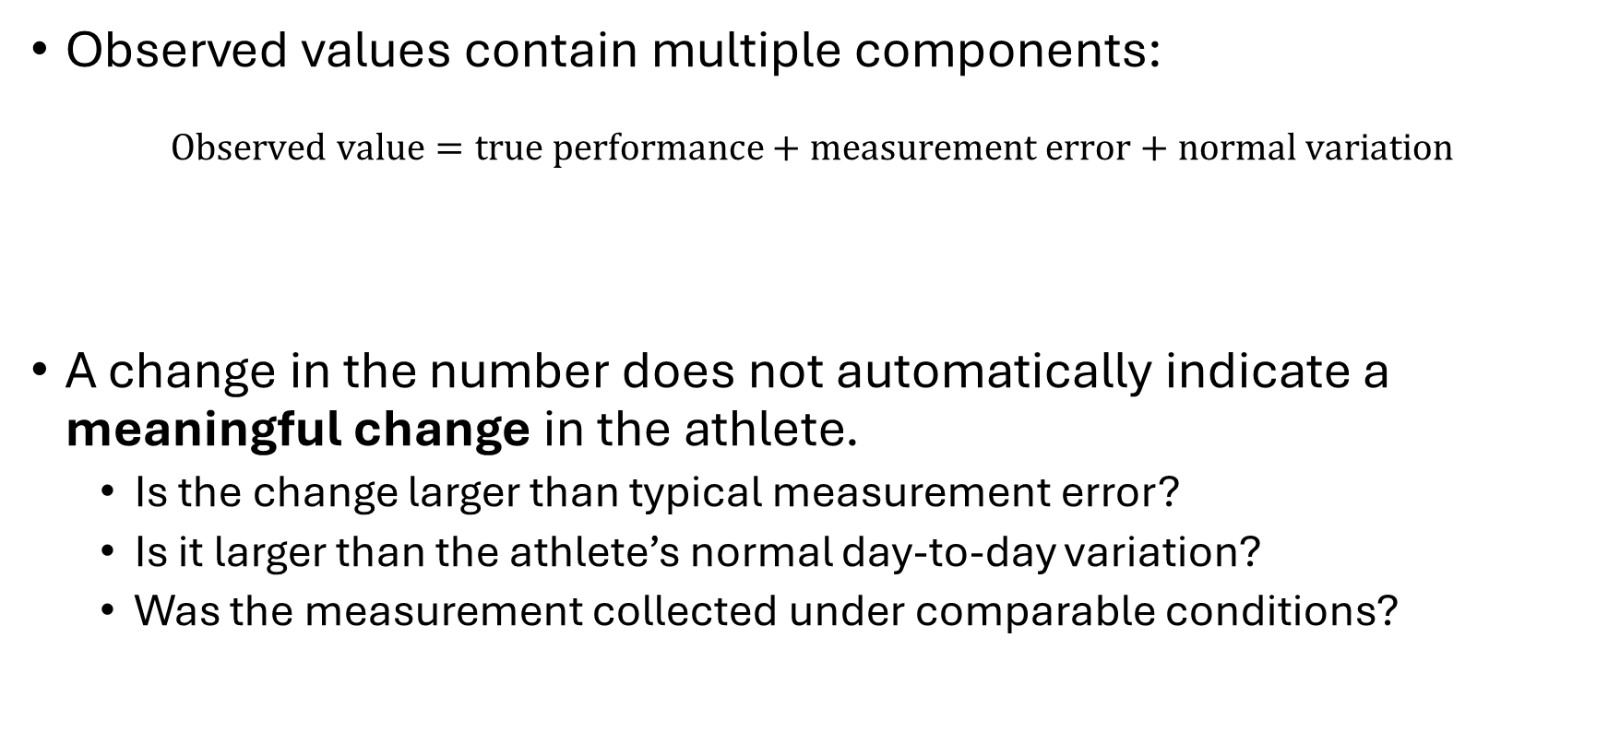
Measurement Error Is Not Athlete Change
Observed values contain multiple components:
$$\text{Observed value}=\text{true performance}+\text{measurement error}+\text{normal variation}$$
A change in the number does not automatically indicate a meaningful change in the athlete.
  Is the change larger than typical measurement error?
  Is it larger than the athlete’s normal day-to-day variation?
  Was the measurement collected under comparable conditions?
We will revisit this when discussing analytics in athlete monitoring

Slide 13
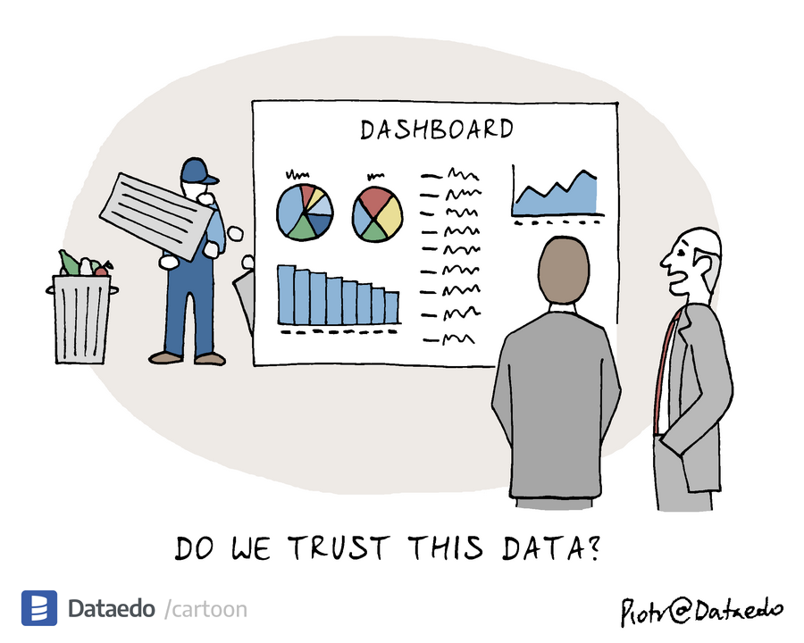
Garbage In, Garbage Out
Your analysis is only as good as your data source
Stats and models cannot fix flawed data
Notes:
There is a saying that originates from the world of computer sience , garbage in garbage out
Stats and models cannot fix flawed data
Your analysis is only as good as your data source
Example:
Wrong tagging, errors in device

Slide 14
Sensor Audit
Think of a wearable or performance-monitoring device you have used. What is one factor that could produce misleading or unusable data?
Possible categories:
  Device placement
  Poor contact
  Environment
  Athlete behavior

Slide 15
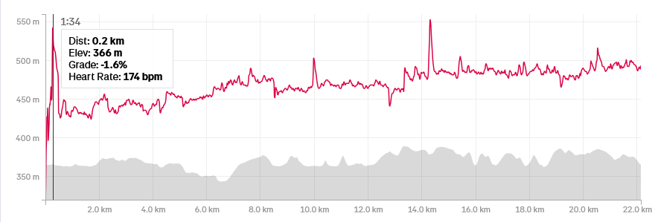
Sensor Audit Example
Poor contact or improper placement of a heart-rate chest strap can produce:
  Missing observations
  Sudden heart-rate spikes
  Delayed responses
  Data that appear real but are physiologically unlikely

Slide 16
Protect your analysis from bad data
Before analyzing a dataset, ask:
  Who collected the data, and why?
  What technology or method was used?
  Has that method been validated for this setting?
  Was the methodology consistent across athletes and over time?
  What values are missing?
  Who or what is not represented?
  What decisions could be affected by the analysis?
  What can the data not establish?

Slide 17
Data-Quality Red Flags
Watch for:
  Impossible or implausible values
  Sudden changes in measurement scale
  Duplicate observations
  Unexplained missing data
  Changes in devices or software
  Inconsistent testing conditions
  Different definitions across seasons
  Metrics with unclear calculations
  Systematic differences between groups
  Values that are unusually perfect

Slide 18
Ethics in Sports Analytics
Notes:
Difficulty finding data for question was most common
Overwhelming, difficult to know what variable applies
Some people seem to have done some level of analysis already
Be careful about jumping to conclusions and/or doing analysis to confirm your view point

Slide 19
Why does it matter?
Athlete data may influence:
  Playing time
  Team selection
  Scholarships
  Contracts
  Injury management
  Return-to-play decisions
  How coaches perceive an athlete

Slide 20
consent and ownership
Athlete monitoring raises several questions:
  Do athletes understand what is being collected?
  Can they meaningfully refuse?
  Who owns the data?
  Who can access it?
  How long will it be stored?
  Can it be used for purposes beyond the original reason for collection?
  What happens when an athlete leaves the team?
Participation is not necessarily the same as informed consent.

Slide 21
weaponization of data
Data collected to support athletes can also be used against them.
  Using wellness responses to question commitment
  Using monitoring data during contract negotiations
  Punishing athletes for reporting fatigue or pain
  Sharing data outside its original purpose
If athletes believe honesty will be punished, they may stop providing honest data.
  This produces both an ethical failure and a data-quality failure.

Slide 22
Establishing Trust
Educate athletes and coaches about what is collected, what the metrics mean, and how the data may be used.
Limit data access to people who need it.
Define acceptable uses before collecting the data.
Establish rules for storage, sharing, and deletion.
Notes:
Possible Solution to consent and weponization issue
Education helps people understand the system. Guardrails protect them when knowledge alone is insufficient.

Slide 23
The resource divide
Funding determines ability to collect data
  Tracking technology
  Staff and technical expertise
  Time for quality control
Better-resourced organizations do not simply have more data. They often have more opportunities to make the data usable.
How does this affect:
  The quality of analytics?
  Outcomes in each domain?

Slide 24
How Does the Resource Divide Affect Analytics?
Lower-resource programs may face:
  Smaller datasets
  Less complete dataset
  Less staff time for cleaning and interpretation
Domain | Possible consequence
Athlete monitoring | Less ability to individualize training or detect meaningful changes
Scouting | Greater reliance on visible athletes and traditional networks
Strategy | Less detailed opponent and game analysis

Slide 25
The invisible athlete
An athlete may be overlooked because they are:
  Outside major recruiting networks
  Playing in a lower-resource environment
  Missing from commercial databases
  Competing against weaker or poorly documented opponents
  Measured using inconsistent methods
  Strong in qualities that the available metrics do not capture
No data does not mean no ability.
  It may only mean that the athlete was never observed by the system.

Slide 26
Making the invisible athlete
Statistical models can only identify athletes represented by their data.
If scouting data primarily include:
  Highly recruited athletes
  Major competitions
  Well-funded programs
  Easily measured performance outcomes
then the resulting analysis may reinforce existing scouting patterns.
A model may learn who traditionally receives opportunities, not who has the most potential.

Slide 27
Finding the invisible athlete
Suppose the original question is:
  Which athletes have the potential to succeed at the next level?
The available data might only allow us to answer:
  Which highly visible athletes currently have the best statistics?
Those are not the same question.
  Changing the question would be easier but it would preserve the same blind spots as everyone else.

Slide 28
Streetlight effect - revisited
The poorly illuminated area may contain the greatest competitive advantage.
Response to limited data:
Streetlight response | Appropriate response
Replace it with what the dataset can easily answer | Preserve the purpose of the question
Analyze only familiar variables | Seek new data or useful proxies
Overstate what available data establish | State uncertainty and limitations
Reproduce existing rankings | Investigate overlooked athletes

Slide 29
Pursuing the harder question
Overlooked athletes may be:
  Less expensive to recruit or acquire
  Undervalued by competitors
  Available later in a draft or recruiting process
  Better than their conventional statistics suggest
If every organization uses the same convenient data, they will tend to identify the same athletes.

Slide 30
Alternative data and methods
When the available data do not answer the original question, analysts can:
  Seek alternative data sources
  Collect new measurements
  Develop proxies for qualities that are difficult to observe
The goal is not to force an answer from inadequate data. It is to find a better way to investigate the original question.

Slide 31
Summary & Looking Ahead
Data are not automatically objective simply because they are numerical. Their credibility depends on how they were collected, interpreted, and used.
Before analysis, consider reliability, validity and ethics.
Next: data characteristics

